Slide 1
CO –PO Management Portal
Hariharan R
2019272010
Project Guide
Ms. S. Kanimozhi

Slide 2
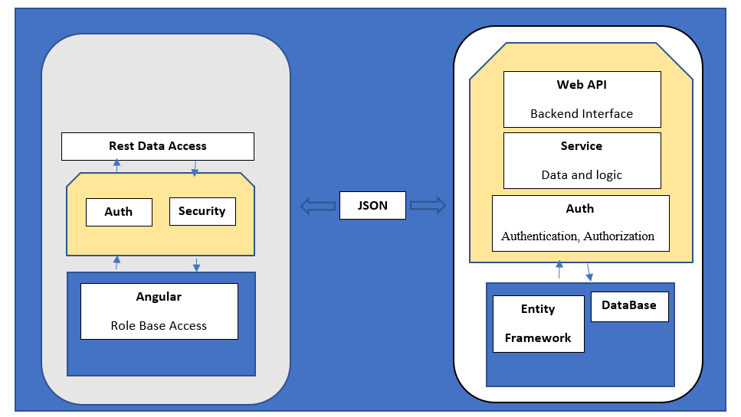
Overall Architecture
DB

Slide 3
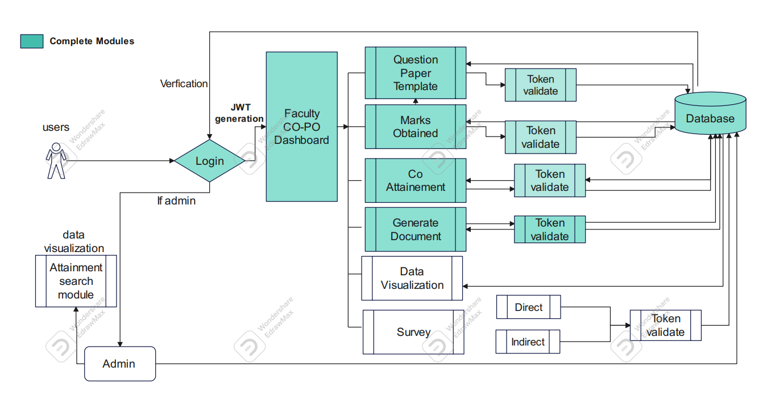
Detailed Architecture
Faculty CO PO
DashBoard
Question Paper
Template
First Review Modules
Token
Validate
Login

Slide 4
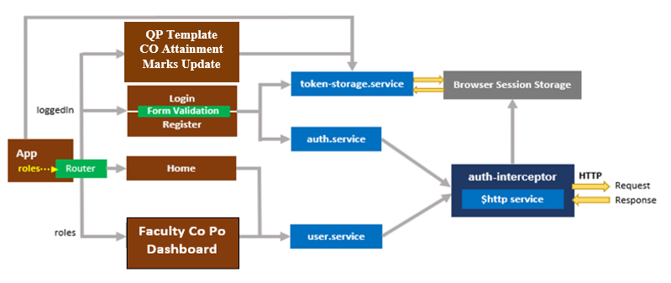
Front-End Flow Diagram

Slide 5
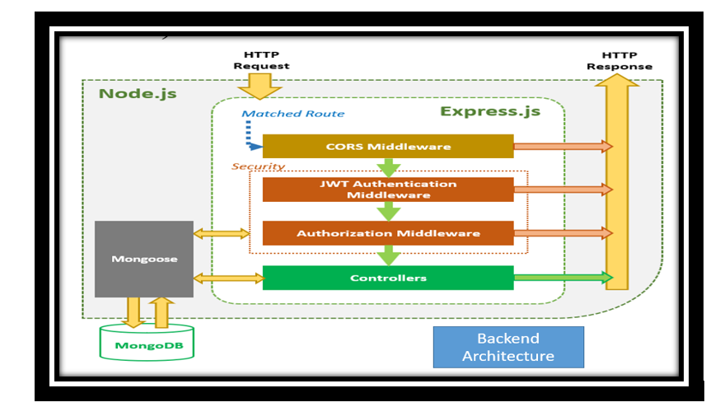
Back-End Flow Diagram

Slide 6
List of Modules
Login Module
Faculty Co-Po Dashboard
Question Paper Template Module
Update Marks Module
Co Attainment Module
Generate Document
Data Visualizing
Survey Module
Direct Method
Indirect Metho
Admin Dashboard

Slide 7
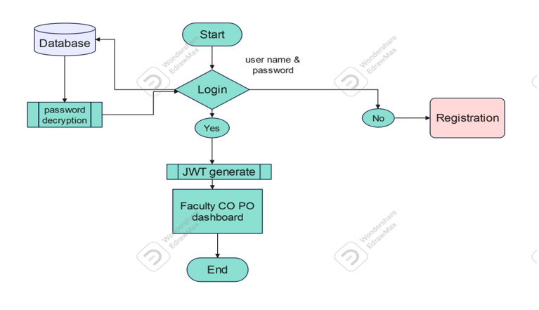
Login Flow Diagram

Slide 8
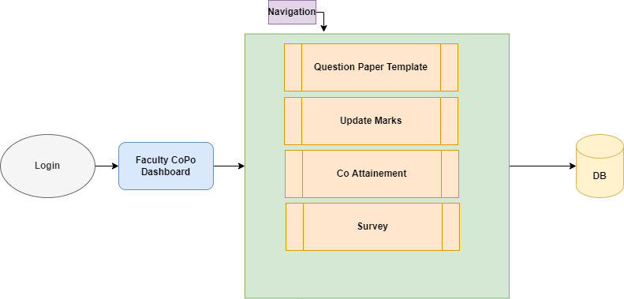
Flow Faculty Co-Po DashBoard

Slide 9
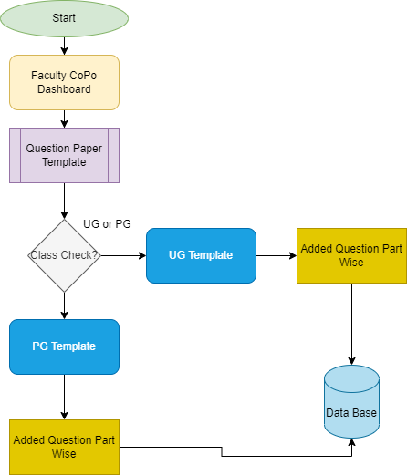
Flow Question Paper Template

Slide 10
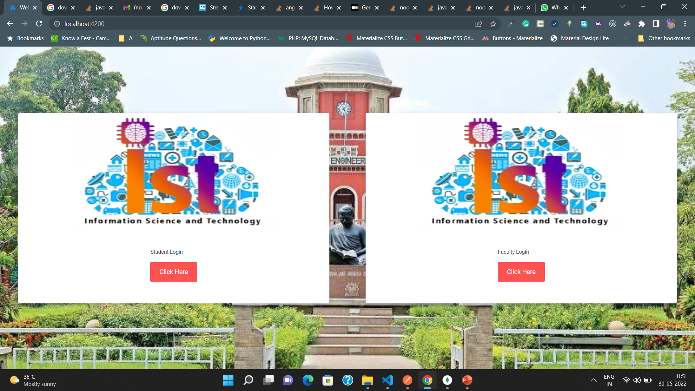

Slide 11
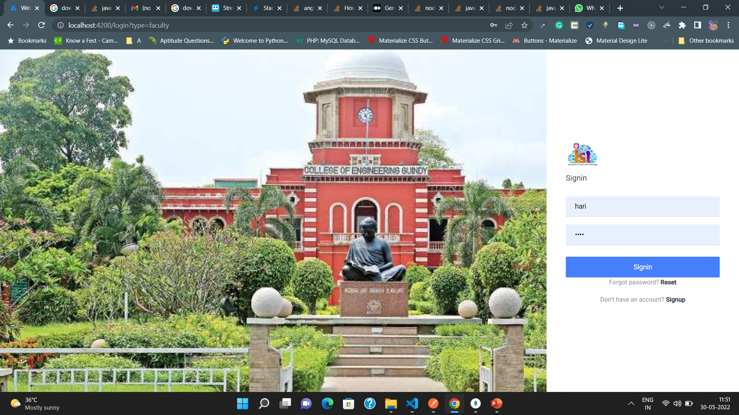

Slide 12
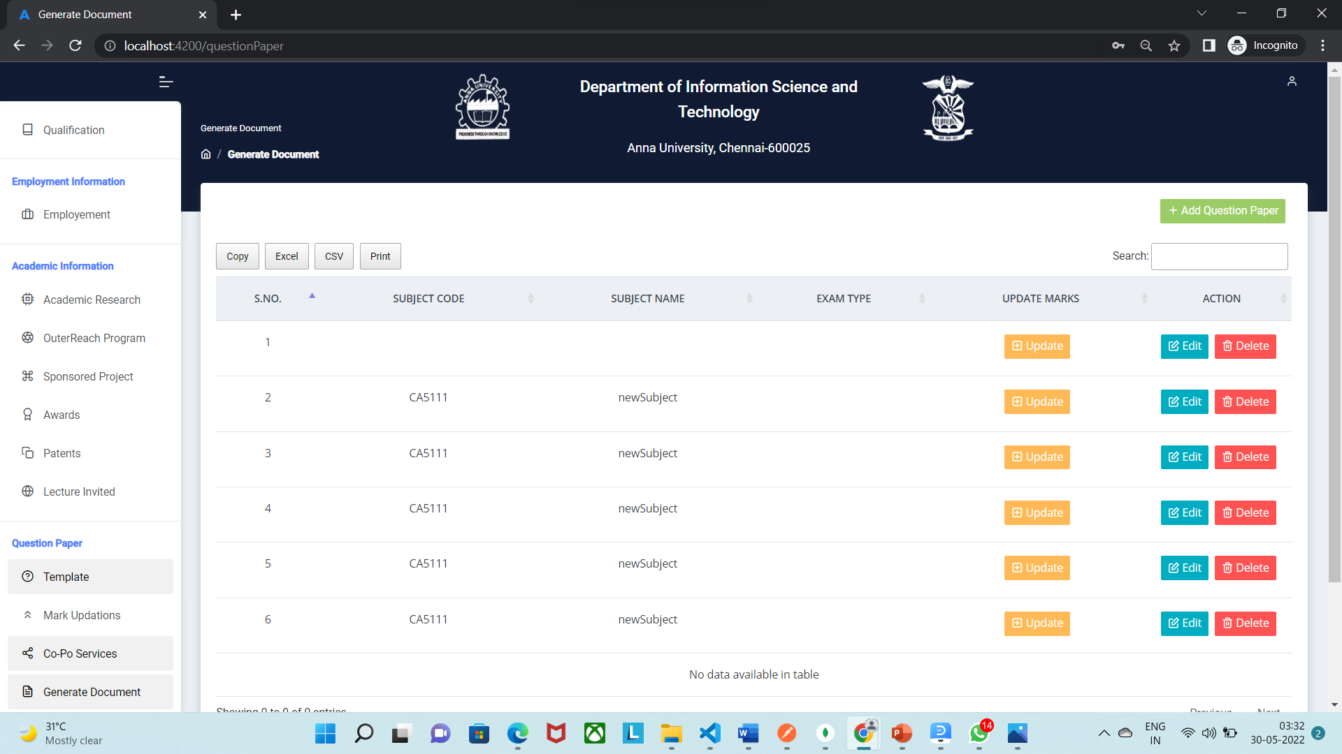

Slide 13
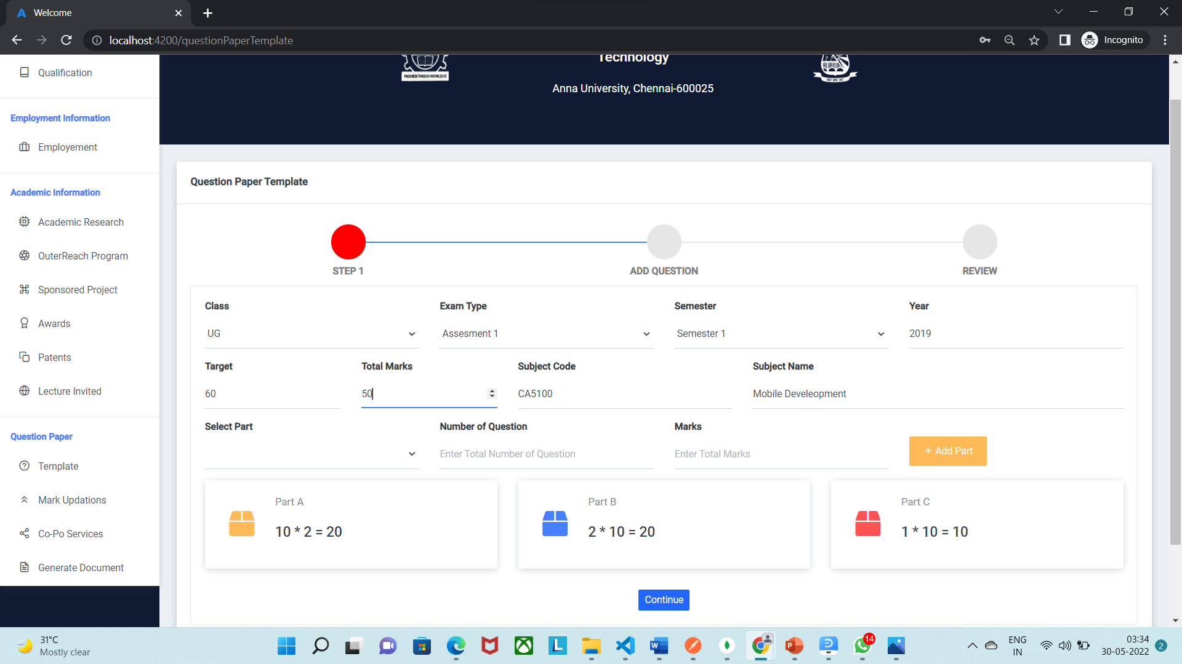

Slide 14
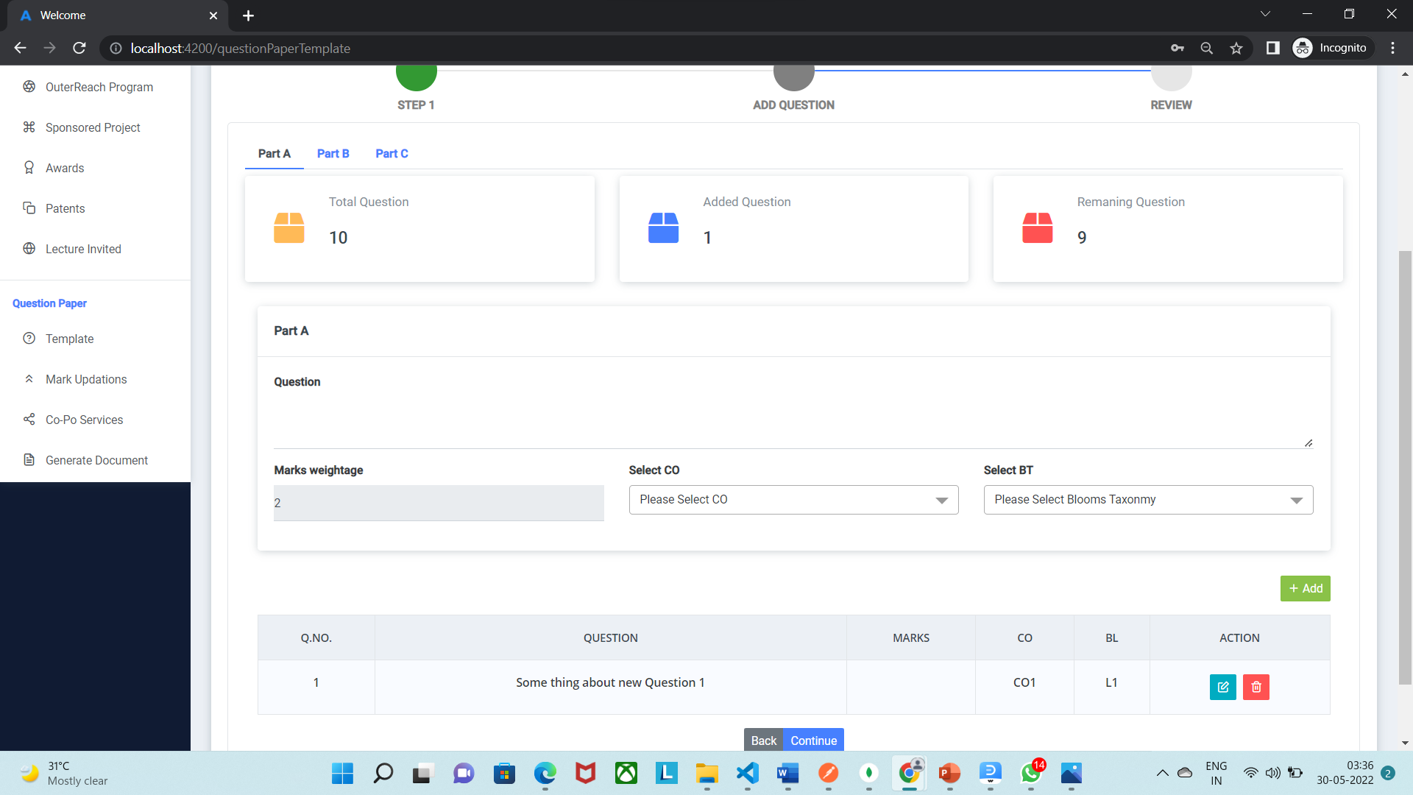
Question paper Template

Slide 15
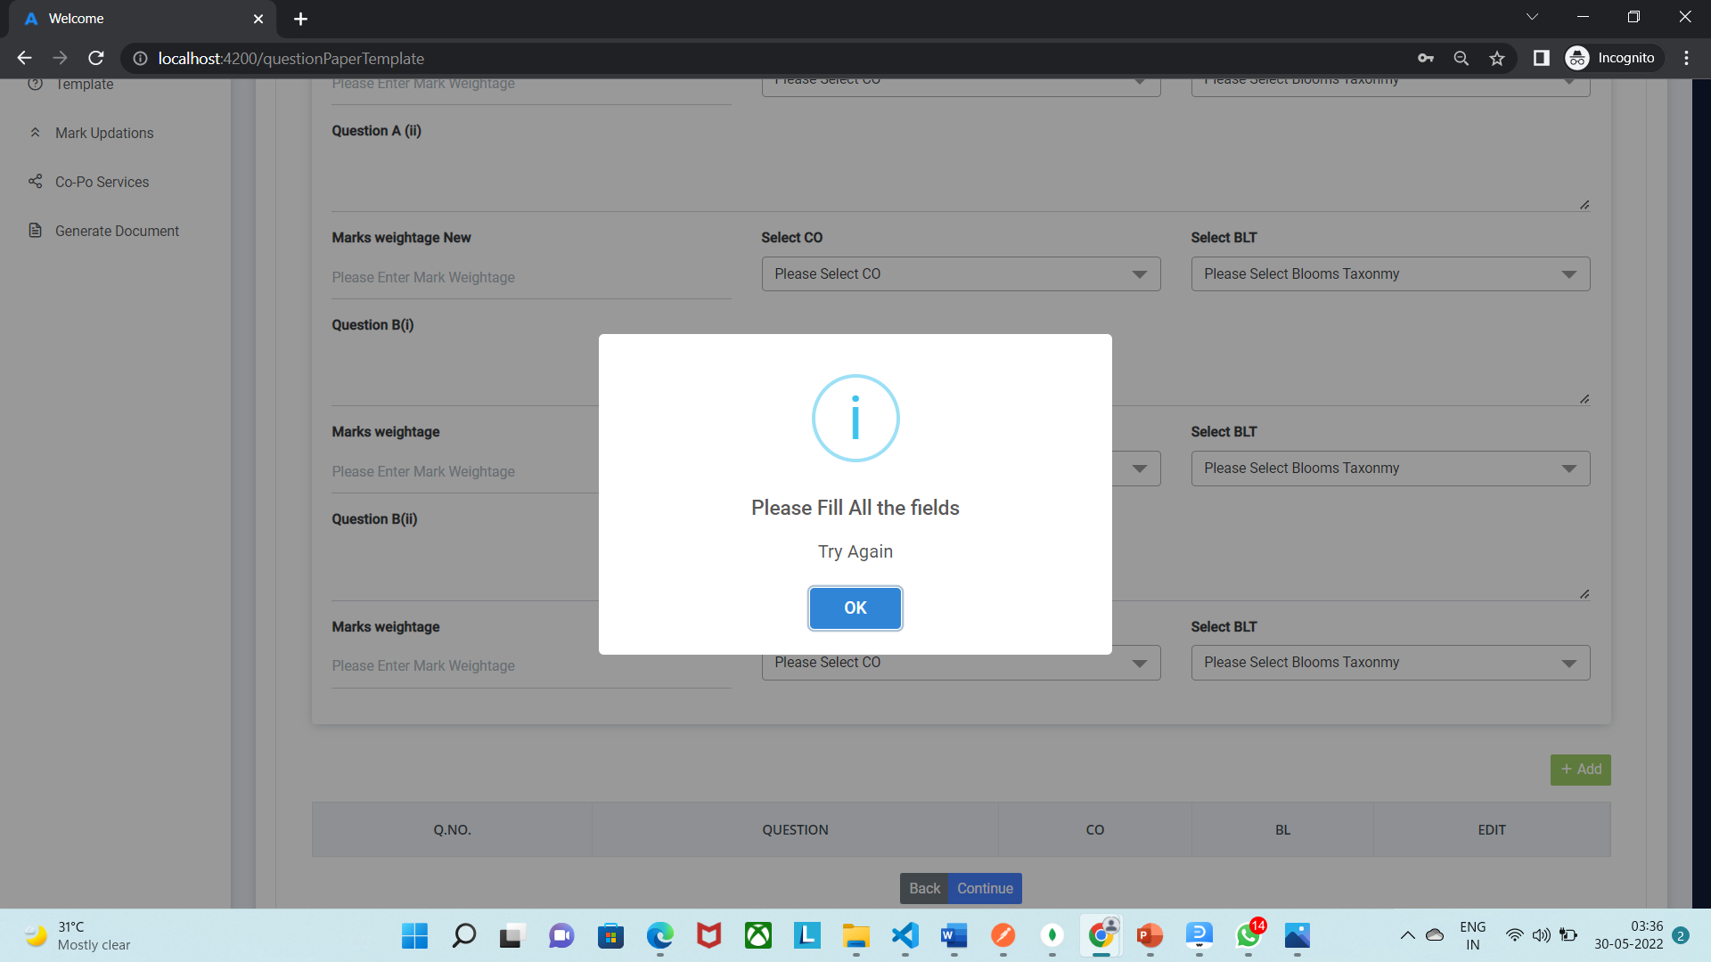
Question paper Template

Slide 16
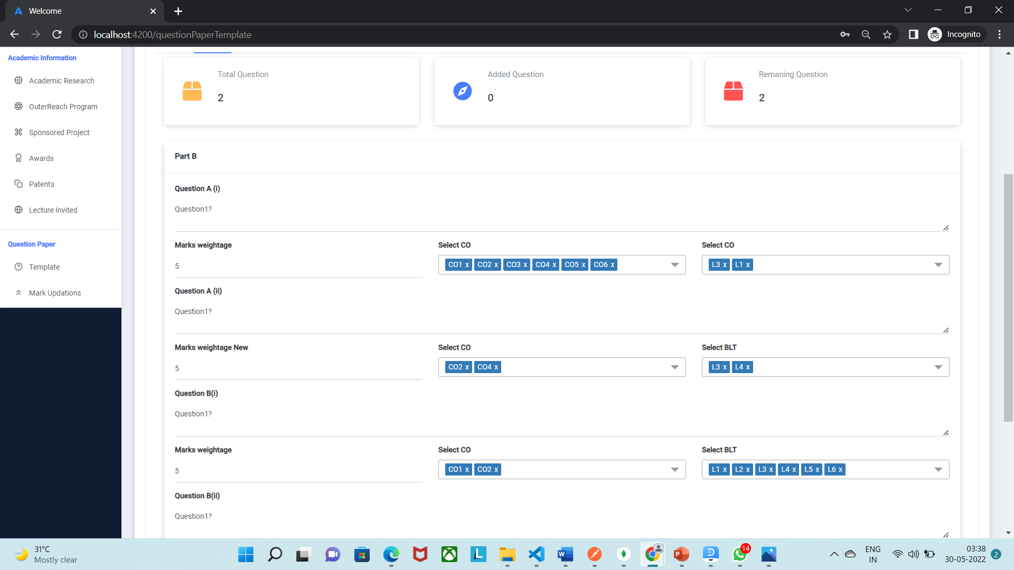
Question paper Template

Slide 17
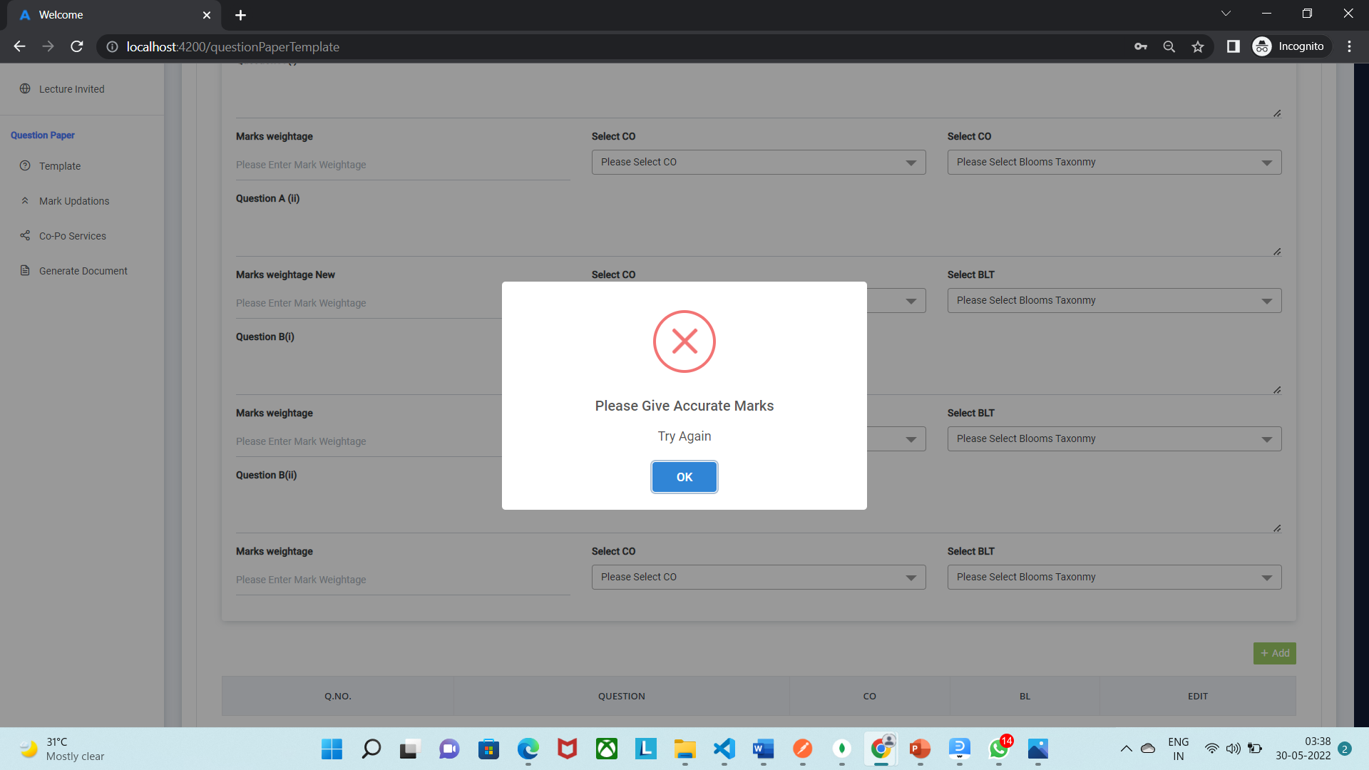
Question paper Template

Slide 18
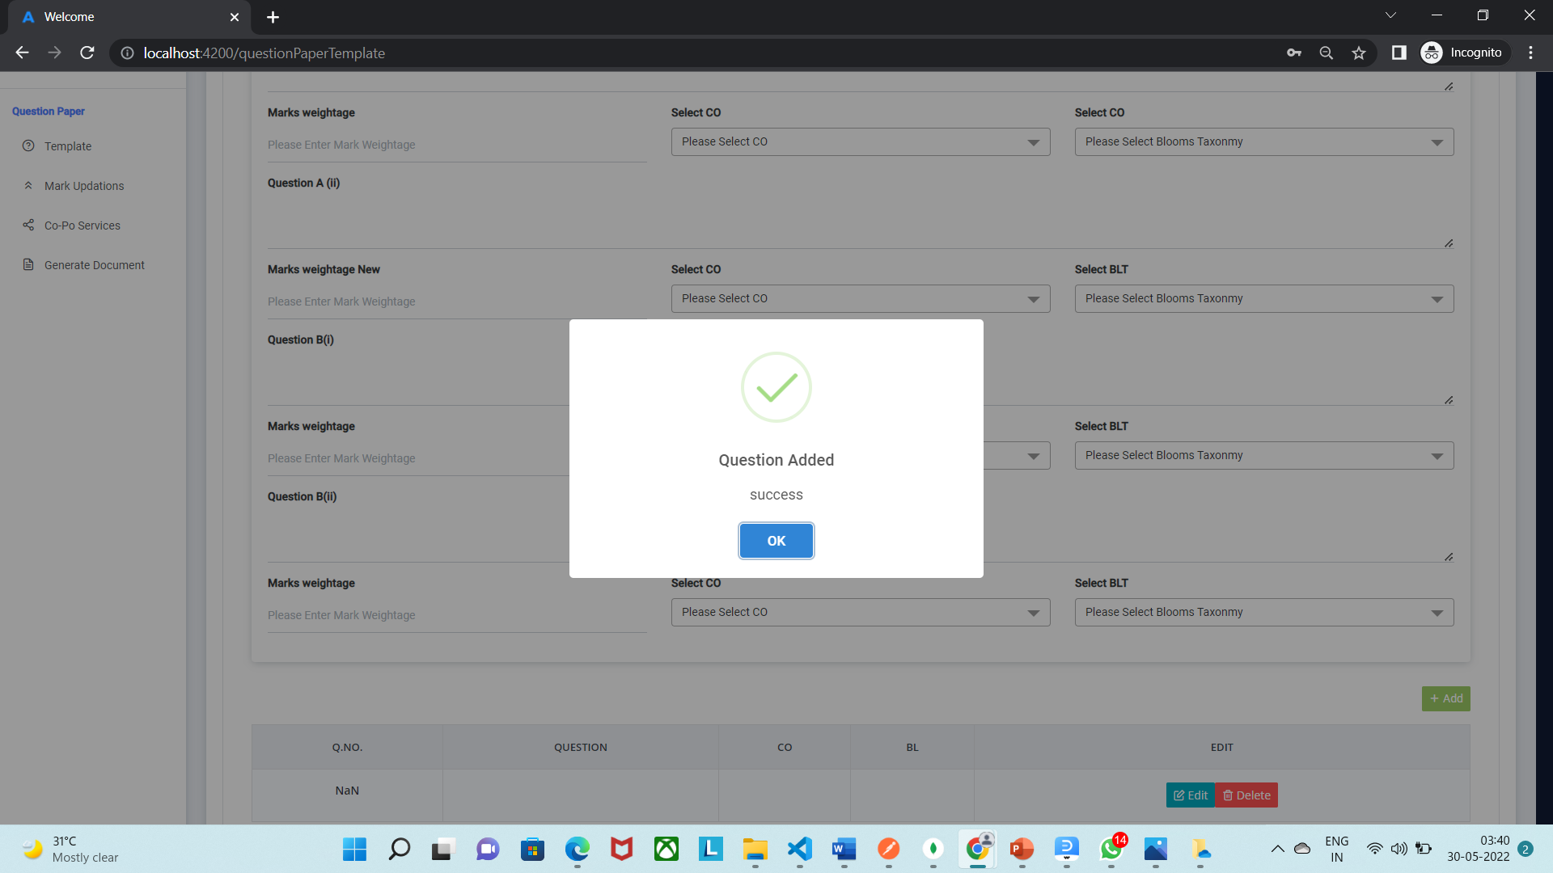
Question paper Template

Slide 19
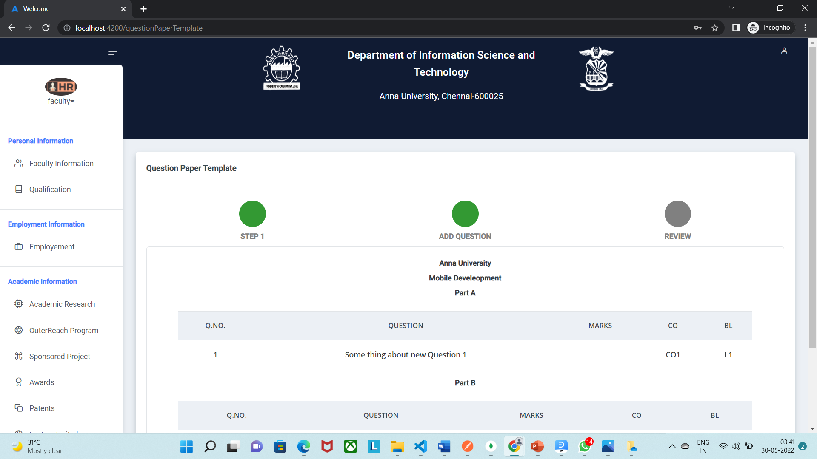
Question paper Template

Slide 20
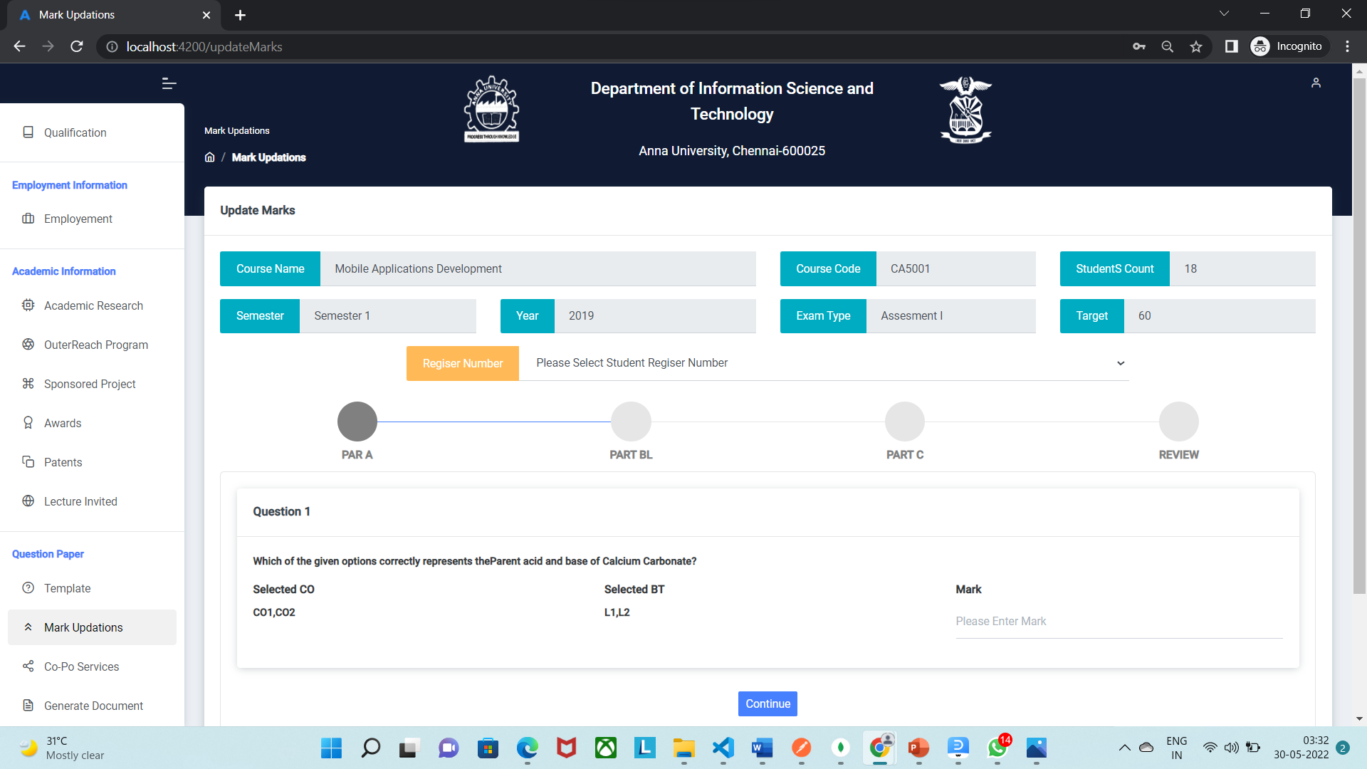

Slide 21
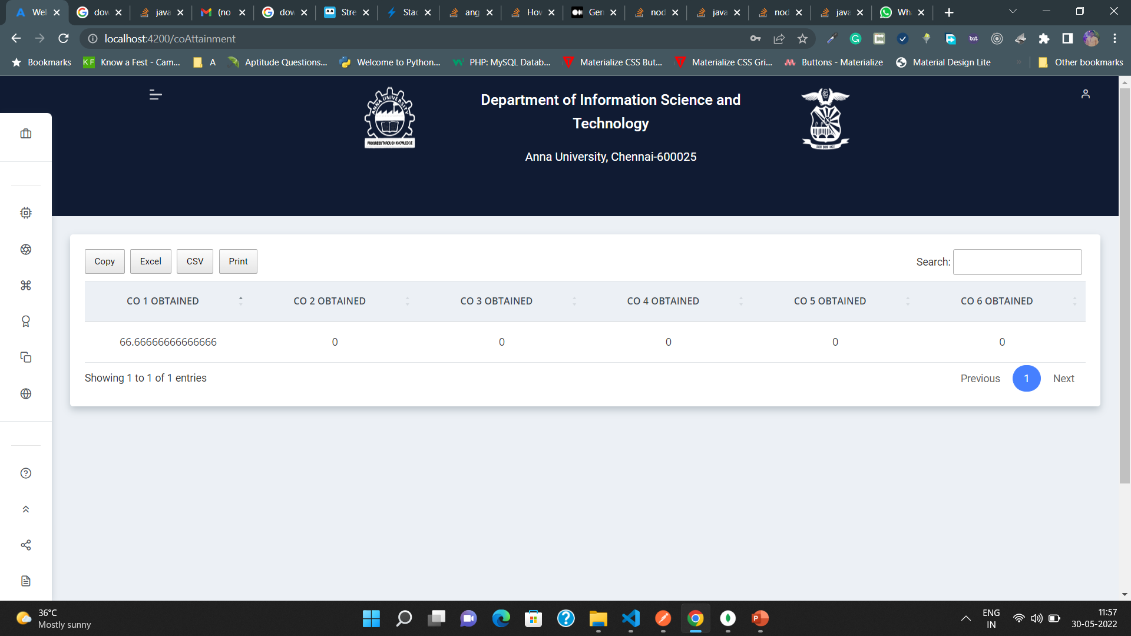

Slide 22
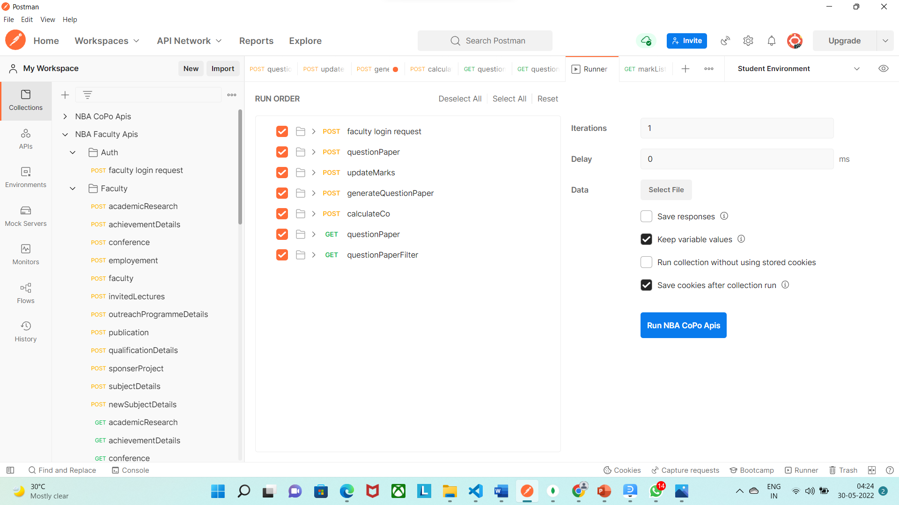
Unit-Testing

Slide 23
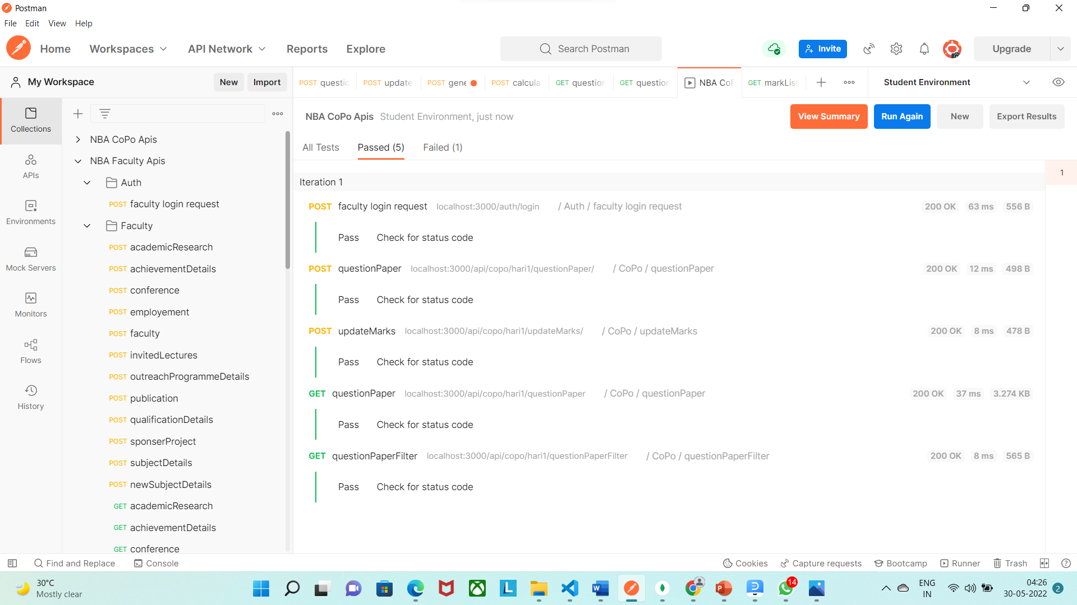
Unit-Testing After Result

Slide 24
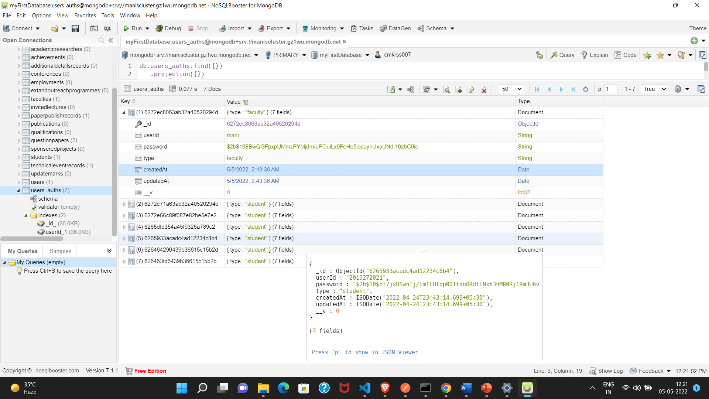
Data Base Testing

Slide 25
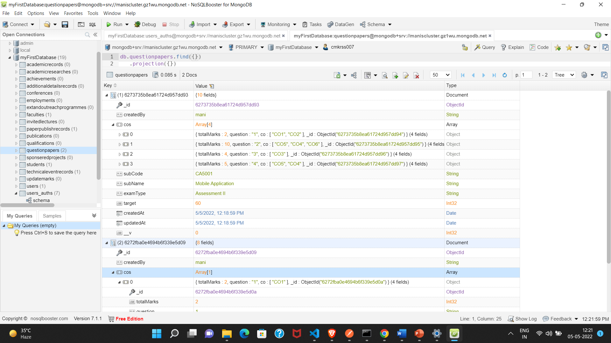
Data Base Testing

Slide 26
REFERENCES
MEAN Stack reference
https://www.researchgate.net/publication/322821888_Simplifying_Web_Application_Development_Using-Mean_Stack_Technologies
Secure transmitting information
https://itnext.io/authentication-using-jwt-in-mean-stack-6b425247b7d8
password hashing:
https://www.loginradius.com/blog/engineering/hashing-user-passwords-using-bcryptjs/

Slide 27
THANK YOU

